Slide 1

Games grading predictions
Amit Yehezkel, Natty Zepko

Slide 2

The situation today
Nowadays people rely on the reviews on steam before buying a game, which both takes time, and isn’t always reliable.
The reviews are considered reliable only when there is a big mass of it, which happens way later down the game’s shelf-life, and by that time the game’s reputation is big enough to warrant it.
Players don’t have a reliable way of knowing how good the game is upon release other than word-of-mouth.

Slide 3

Agenda
Collect information from Steam about popular games
Analyze, filter, and manipulate the data
Predict the positive / negative ratio of reviews

Slide 4

Predicting the reviews
With a good prediction review model, we will be able to buy good games on release, or closer to the release date rather than waiting for the reviews to arrive (which risk spoilers, and sometimes aren’t accurate on day 1)
By using the model, we may ensure players can rely on the data before the reviews are pouring in.

Slide 5
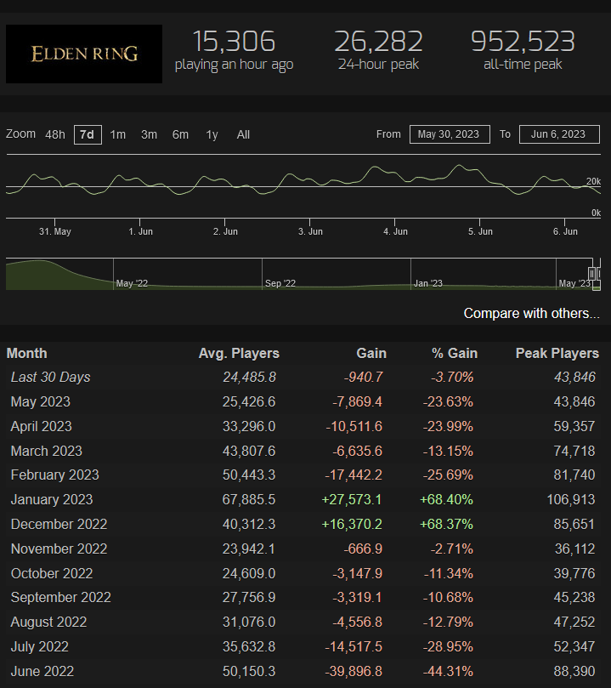
The Data
The dataset
Our approach
Steam API, and Steam charts API provide accurate data for recent players, play time, etc.
From Steam API we can get the Publisher, Developer, Prices, Tags, etc.
Kafka will manage the data and Spark will process it to run the algorithm we will create
The data can be saved in a simple csv format and fed into the algorithm for fast analysis.

Slide 6
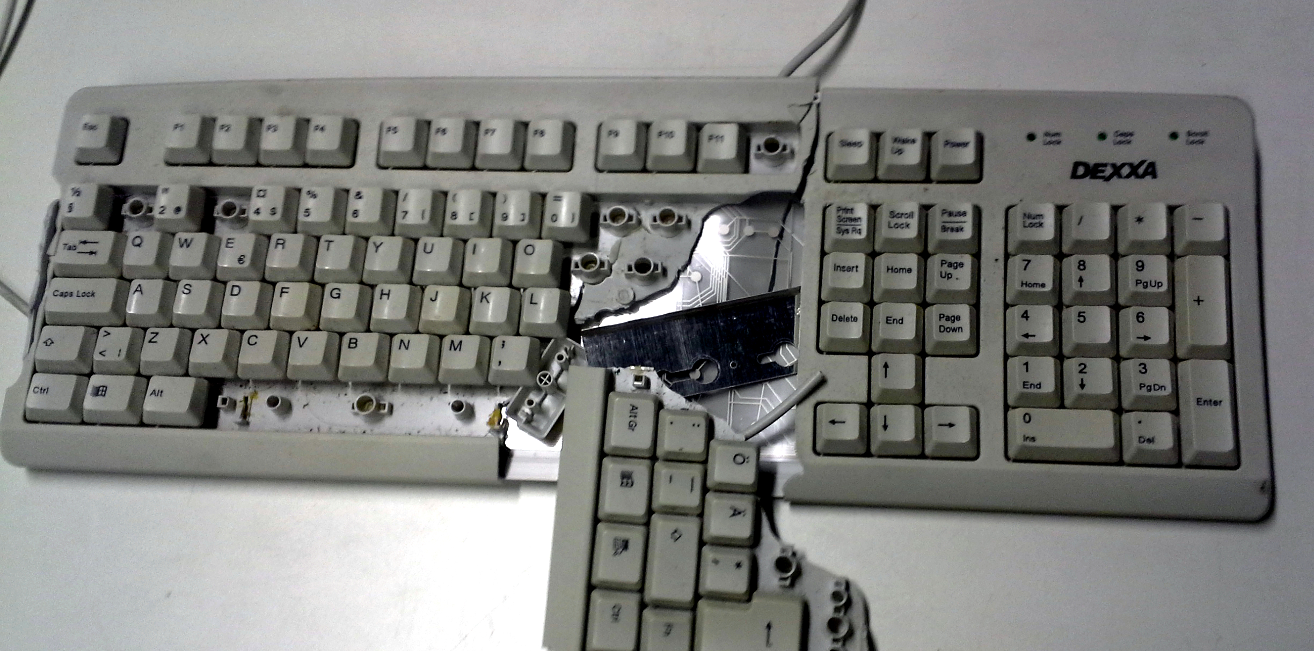

Thank you for playing. GG
Natty Zepko
Amit Yehezkel
Boris ☺

